Slide 1
Ardent PPT
PPT on JSP

Slide 2
PPT on JSP
JSP technology is used to create web application just like Servlet technology. It can be thought of as an extension to servlet because it provides more functionality than servlet such as expression language, jstl etc.
A JSP page consists of HTML tags and JSP tags. The jsp pages are easier to maintain than servlet because we can separate designing and development. It provides some additional features such as Expression Language, Custom Tag etc.

Slide 3
PPT on JSP
Advantages of JSP Over Servlet:-
Extension to Servlet
Easy to maintain
Fast Deployment: No need to recompile and redeploy
Less Code than Servlet.

Slide 4
PPT on JSP
Lifecycle of JSP:- The JSP pages follows these phases:
Translation of JSP Page
Compilation of JSP Page
Classloading (class file is loaded by the classloader)
Instantiation (Object of the Generated Servlet is created).
Initialization ( jspInit() method is invoked by the container).
Reqeust processing ( _jspService() method is invoked by the container).
Destroy ( jspDestroy() method is invoked by the container).

Slide 5
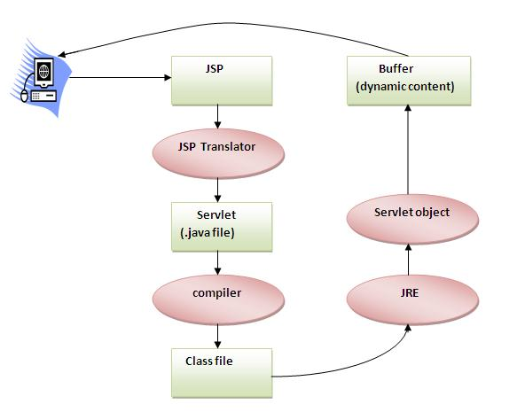
PPT on JSP
Lifecycle of JSP:-

Slide 6
PPT on JSP
Create a page using JSP:-
To create the first jsp page, write some html code as given below, and save it by .jsp extension. We have save this file as index.jsp. Put it in a folder and paste the folder in the web-apps directory in apache tomcat to run the jsp page.
<html>
<body>
<% out.print(2*5); %>
</body>
</html>
It will print 10 on browser.

Slide 7
PPT on JSP
JSP Scriplet Tag Element:- In JSP, java code can be written inside the jsp page using the scriptlet tag. Let's see what are the scripting elements first.
JSP Scripting Element:-
The scripting elements provides the ability to insert java code inside the jsp. There are three types of scripting elements:
scriptlet tag
expression tag
declaration tag

Slide 8
PPT on JSP
JSP Scriplet Tag:- A scriptlet tag is used to execute java source code in JSP. Syntax is as follows:
<% java source code %>
E.g. of JSP Scriplet Tag:-
<html>
<body>
<% out.print("welcome to jsp"); %>
</body>
</html>
It will show Output welcome to jsp.

Slide 9
PPT on JSP
JSP Declaration Tag:- The JSP declaration tag is used to declare fields and methods.
Syntax of JSP declaration tag:-
<%! field or method declaration %>

Slide 10
PPT on JSP
E.g. of JSP Declaration Tag that declares method:- In this example of JSP declaration tag, we are defining the method which returns the cube of given number and calling this method from the jsp expression tag. But we can also use jsp scriptlet tag to call the declared method.
<html>
<body>
<%!
int cube(int n){
return n*n*n*;
}
%>
<%= "Cube of 3 is:"+cube(3) %>
</body>
</html>

Slide 11
PPT on JSP
JSP Implicit Object:- These objects are created by the web container that are available to all the jsp pages.
The available implicit objects are out, request, config, session, application etc.
Object | Type
out | JspWriter
request | HttpServletRequest
response | HttpServletResponse
config | ServletConfig
application | ServletContext
session | HttpSession
pageContext | PageContext
page | Object
exception | Throwable

Slide 12
PPT on JSP
JSP Response Implicit Object:-

